Slide 1
New development in OTR
https://www.otr.im
Jurre van Bergen

Slide 2
Who am I?
Jurre Van Bergen
me@jurrevanbergen.nl
PGP: 2976 FD1A 2ABE FB14 3907 58CE B739 2967 EA80 1D02

Slide 3
What is OTR?
Decade young
Protocol agnostic
Offers great security
Peer-reviewed design
Open source

Slide 4
But...
OTR is an ecosystem

Slide 5
But...
OTR is an ecosystem.
Reference implementations are incomplete.

Slide 6
But...
OTR is an ecosystem.
Reference implementations are incomplete.
Clients are often unsafe/unusable.

Slide 7
But...
OTR is an ecosystem.
Reference implementations are incomplete.
Clients are often unsafe/unusable.
Crypto is bypassed.

Slide 8
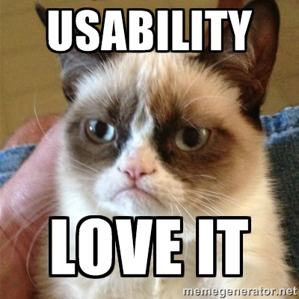

OTR.im
Usability is the name of the game no matter what
Usability is a security feature!

Slide 9









State of OTR

Slide 10
State of OTR
OTR Libraries
Libotr - http://www.cypherpunks.ca/otr
  Created by Ian Goldberg and co.
  C library – Reference implementation
Pure Python OTR
Otr4j – Java implementation
Go, Scheme and JavaScript also have a library.

Slide 11
IMs client
Written in a more memory-safe languages.
Written with security, privacy and UX by design
Tor support!
OTR support
np(1)sec?

Slide 12
New chat paradigm
Sync and async communication.
  Offline message.
Integrated media files (video, audio, image)
Protocol agnostic?
Switch between mobile device and desktop
Not only a new client with better feature
but a distinct user experience.

Slide 13
How can you help?
Work on better IM clients.
Audit software
Donate

Slide 14
This is the end...
Please help improve secure communication!
Irc.OFTC.net #otr
Mailing list: otr-dev@lists.cypherpunks.ca

